Slide 1
Deterministic Finite Automaton

Slide 2
Finite Automaton can be classified into two types
Deterministic Finite Automaton (DFA)
Non-deterministic Finite Automaton (NDFA / NFA)

Slide 3
Deterministic Finite Automaton (DFA)
In DFA, for each input symbol, one can determine the state to which the machine will move. Hence, it is called Deterministic Automaton. As it has a finite number of states, the machine is called Deterministic Finite Machine or Deterministic Finite Automaton.

Slide 4
Formal Definition of a DFA
DFA can be represented by a 5-tuple (Q, ∑, δ, q₀, F) where −
Q is a finite set of states.
∑ is a finite set of symbols called the alphabet.
δ is the transition function where δ: Q × ∑ → Q
q₀ is the initial state from where any input is processed (q₀ ∈ Q).
F is a set of final state/states of Q (F ⊆ Q).

Slide 5
Graphical Representation of a DFA
A DFA is represented by digraphs called state diagram.
The vertices represent the states.
The arcs labeled with an input alphabet show the transitions.
The initial state is denoted by an empty single incoming arc.
The final state is indicated by double circles.

Slide 6
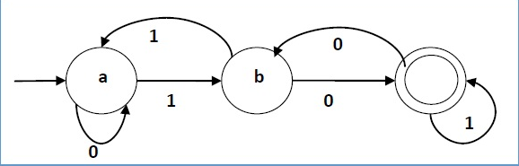
Its graphical representation would be as follows

Slide 7
Example
Let a deterministic finite automaton be →
Q = {a, b, c},
∑ = {0, 1},
q₀ = {a},
F = {c}, and
Transition function δ as shown by the following table −
Present State | Next State for Input 0 | Next State for Input 1
a | a | b
b | c | a
c | b | c

Slide 8
Non-deterministic Finite Automaton (NDFA / NFA)

Slide 9
Non-deterministic Finite Automaton (NDFA / NFA)
In NDFA, for a particular input symbol, the machine can move to any combination of the states in the machine. In other words, the exact state to which the machine moves cannot be determined. Hence, it is called Non-deterministic Automaton. As it has finite number of states, the machine is called Non-deterministic Finite Machine or Non-deterministic Finite Automaton.

Slide 10
Formal Definition of an NDFA
An NDFA can be represented by a 5-tuple (Q, ∑, δ, q₀, F) where −
Q is a finite set of states.
∑ is a finite set of symbols called the alphabets.
δ is the transition function where δ: Q × ∑ → 2^{Q}
(Here the power set of Q (2^{Q}) has been taken because in case of NDFA, from a state, transition can occur to any combination of Q states)
q₀ is the initial state from where any input is processed (q₀ ∈ Q).
F is a set of final state/states of Q (F ⊆ Q).

Slide 11
Graphical Representation of an NDFA: (same as DFA)
An NDFA is represented by digraphs called state diagram.
The vertices represent the states.
The arcs labeled with an input alphabet show the transitions.
The initial state is denoted by an empty single incoming arc.
The final state is indicated by double circles.

Slide 12
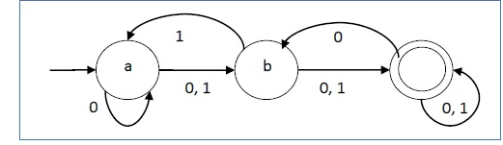
Its graphical representation would be as follows

Slide 13
Example
Let a non-deterministic finite automaton be →
Q = {a, b, c}
∑ = {0, 1}
q₀ = {a}
F = {c}
The transition function δ as shown below −
Present State | Next State for Input 0 | Next State for Input 1
a | a, b | b
b | c | a, c
c | b, c | c

Slide 14
DFA vs NDFA

Slide 15
DFA vs NDFA
DFA | NDFA
The transition from a state is to a single particular next state for each input symbol. Hence it is called deterministic. | The transition from a state can be to multiple next states for each input symbol. Hence it is called non-deterministic.
Empty string transitions are not seen in DFA. | NDFA permits empty string transitions.
Backtracking is allowed in DFA | In NDFA, backtracking is not always possible.
Requires more space. | Requires less space.
A string is accepted by a DFA, if it transits to a final state. | A string is accepted by a NDFA, if at least one of all possible transitions ends in a final state.

Slide 16
Acceptors, Classifiers, and Transducers
Acceptor (Recognizer)
An automaton that computes a Boolean function is called an acceptor. All the states of an acceptor is either accepting or rejecting the inputs given to it.
Classifier
A classifier has more than two final states and it gives a single output when it terminates.
Transducer
An automaton that produces outputs based on current input and/or previous state is called a transducer. Transducers can be of two types −
Mealy Machine − The output depends both on the current state and the current input.
Moore Machine − The output depends only on the current state.

Slide 17
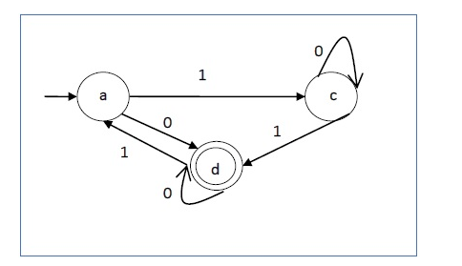
Predict the Language accepted by the DFA below:

Slide 18
Strings accepted by the above DFA: {0, 00, 11, 010, 101, ...........} Strings not accepted by the above DFA: {1, 011, 111, ........}

Slide 19
Regular Expression

Slide 20
A Regular Expression can be recursively defined as follows −
ε is a Regular Expression indicates the language containing an empty string. (L (ε) = {ε})
φ is a Regular Expression denoting an empty language. (L (φ) = { })
x is a Regular Expression where L = {x}
If X is a Regular Expression denoting the language L(X) and Y is a Regular Expression denoting the language L(Y), then
X + Y is a Regular Expression corresponding to the language L(X) ∪ L(Y) where L(X+Y) = L(X) ∪ L(Y).
X . Y is a Regular Expression corresponding to the language L(X) . L(Y) where L(X.Y) = L(X) . L(Y)
R* is a Regular Expression corresponding to the language L(R*)where L(R*) = (L(R))*

Slide 21
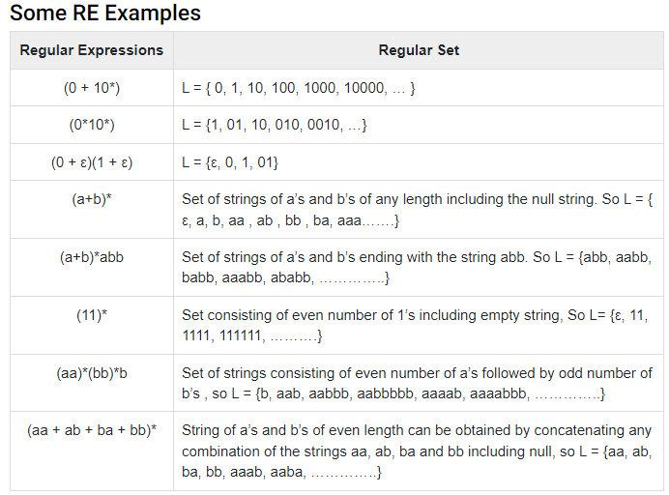
If we apply any of the rules several times from 1 to 5, they are Regular Expressions.

Slide 22
Any set that represents the value of the Regular Expression is called a Regular Set.
Properties of Regular Sets
Property 1. The union of two regular set is regular.
Proof −
Let us take two regular expressions
RE₁ = a(aa)* and RE₂ = (aa)*
So, L₁ = {a, aaa, aaaaa,.....} (Strings of odd length excluding Null)
and L₂ ={ ε, aa, aaaa, aaaaaa,.......} (Strings of even length including Null)
L₁ ∪ L₂ = { ε, a, aa, aaa, aaaa, aaaaa, aaaaaa,.......}
(Strings of all possible lengths including Null)
RE (L₁ ∪ L₂) = a* (which is a regular expression itself)
Hence, proved.

Slide 23
Property 2. The intersection of two regular set is regular.
Proof −
Let us take two regular expressions
RE₁ = a(a*) and RE₂ = (aa)*
So, L₁ = { a,aa, aaa, aaaa, ....} (Strings of all possible lengths excluding Null)
L₂ = { ε, aa, aaaa, aaaaaa,.......} (Strings of even length including Null)
L₁ ∩ L₂ = { aa, aaaa, aaaaaa,.......} (Strings of even length excluding Null)
RE (L₁ ∩ L₂) = aa(aa)* which is a regular expression itself.
Hence, proved.

Slide 24
Property 3. The complement of a regular set is regular.
Proof −
Let us take a regular expression −
RE = (aa)*
So, L = {ε, aa, aaaa, aaaaaa, .......} (Strings of even length including Null)
Complement of L is all the strings that is not in L.
So, L’ = {a, aaa, aaaaa, .....} (Strings of odd length excluding Null)
RE (L’) = a(aa)* which is a regular expression itself.
Hence, proved.

Slide 25
Property 4. The difference of two regular set is regular.
Proof −
Let us take two regular expressions −
RE₁ = a (a*) and RE₂ = (aa)*
So, L₁ = {a, aa, aaa, aaaa, ....} (Strings of all possible lengths excluding Null)
L₂ = { ε, aa, aaaa, aaaaaa,.......} (Strings of even length including Null)
L₁ – L₂ = {a, aaa, aaaaa, aaaaaaa, ....}
(Strings of all odd lengths excluding Null)
RE (L₁ – L₂) = a (aa)* which is a regular expression.
Hence, proved.

Slide 26
Property 5. The reversal of a regular set is regular.
Proof −
We have to prove L^{R} is also regular if L is a regular set.
Let, L = {01, 10, 11, 10}
RE (L) = 01 + 10 + 11 + 10
L^{R} = {10, 01, 11, 01}
RE (L^{R}) = 01 + 10 + 11 + 10 which is regular
Hence, proved.

Slide 27
Property 6. The closure of a regular set is regular.
Proof −
If L = {a, aaa, aaaaa, .......} (Strings of odd length excluding Null)
i.e., RE (L) = a (aa)*
L* = {a, aa, aaa, aaaa , aaaaa,……………} (Strings of all lengths excluding Null)
RE (L*) = a (a)*
Hence, proved.

Slide 28
Property 7. The concatenation of two regular sets is regular.
Proof −
Let RE₁ = (0+1)*0 and RE₂ = 01(0+1)*
Here, L₁ = {0, 00, 10, 000, 010, ......} (Set of strings ending in 0)
and L₂ = {01, 010,011,.....} (Set of strings beginning with 01)
Then, L₁ L₂ = {001,0010,0011,0001,00010,00011,1001,10010,.............}
Set of strings containing 001 as a substring which can be represented by an RE − (0 + 1)*001(0 + 1)*
Hence, proved.

